Slide 1
2025-05-27

Slide 2
Beyond Chatbots Intro to Agentic Applications
Simon Stone
Research Software Engineer for HPC and AI
Research Computing @ ITC, Dartmouth College

Slide 3
Introducing Research Software Engineering
Collaborative expertise in software engineering, designed to bridge the gap between innovative ideas and impactful outcomes. Our services include:
Grant Proposal Consulting to ensure accurate resource estimations and project feasibility.
Rapid Prototyping to refine concepts and explore solutions.
Ongoing Application Support and Application Rehabilitation for existing applications.
Open-Source Releases to share knowledge and contribute to the wider community.
Contact us today to discuss your project and discover how Research Software Engineering can be your trusted partner in innovation.

Slide 4
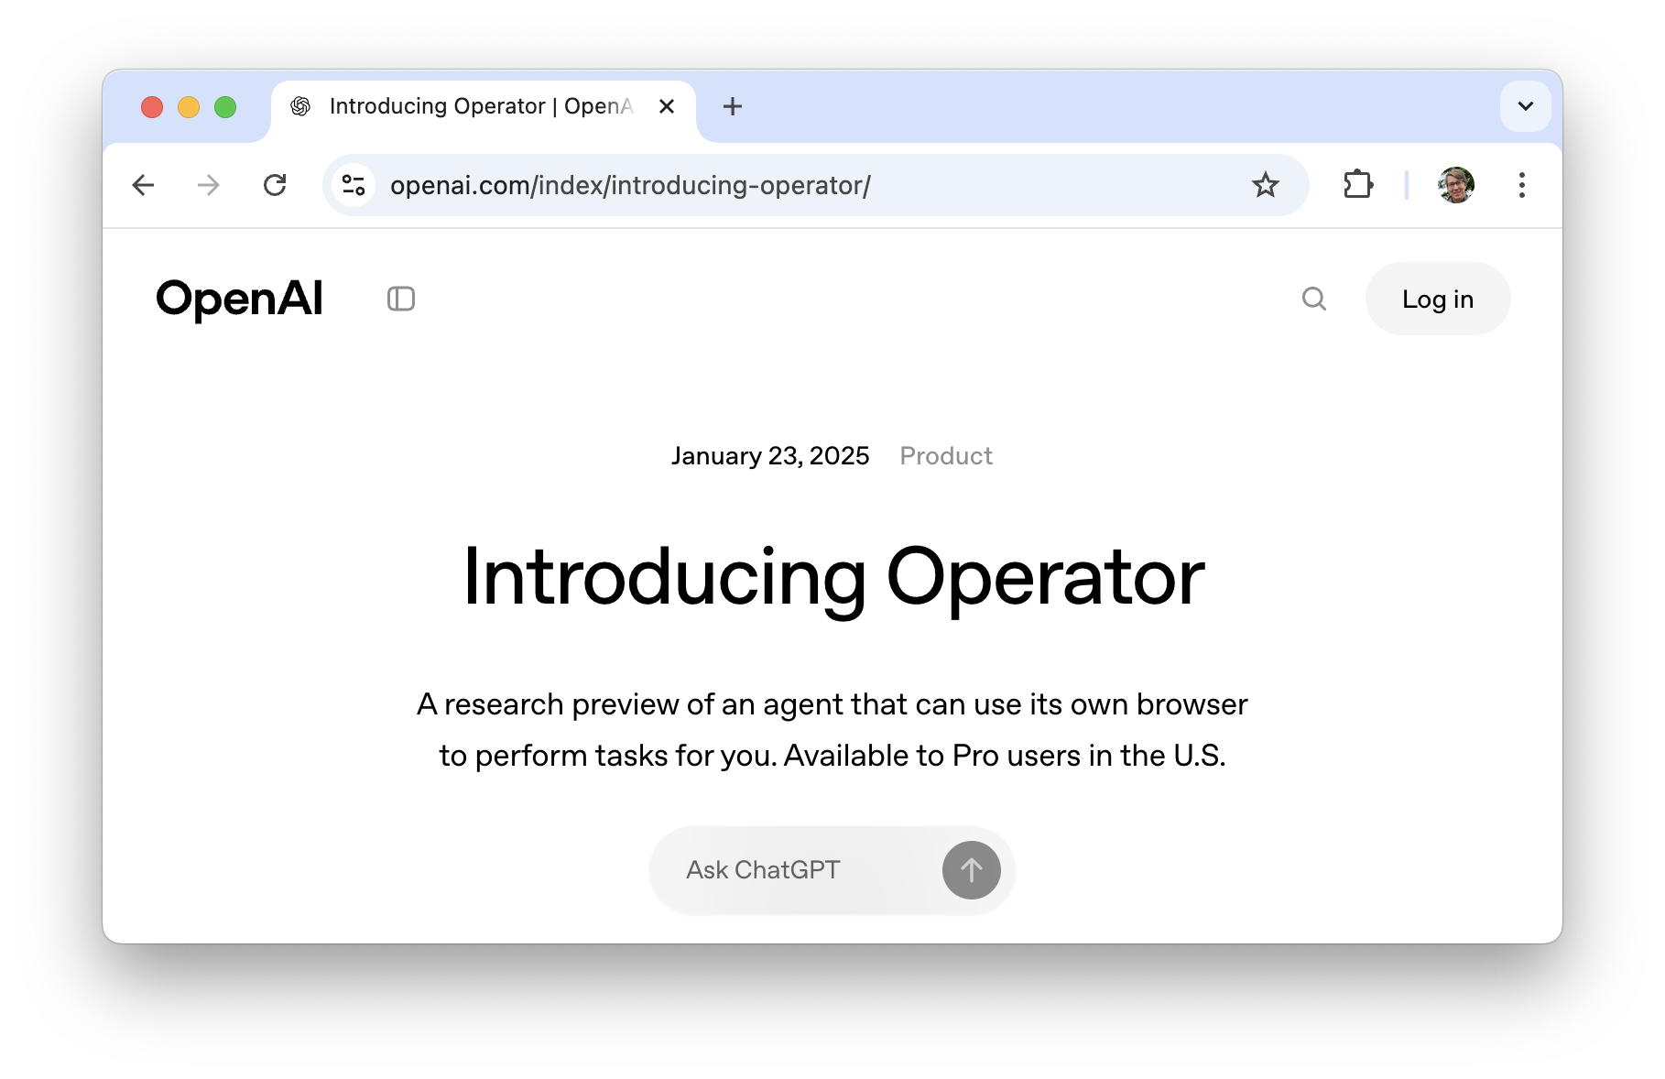
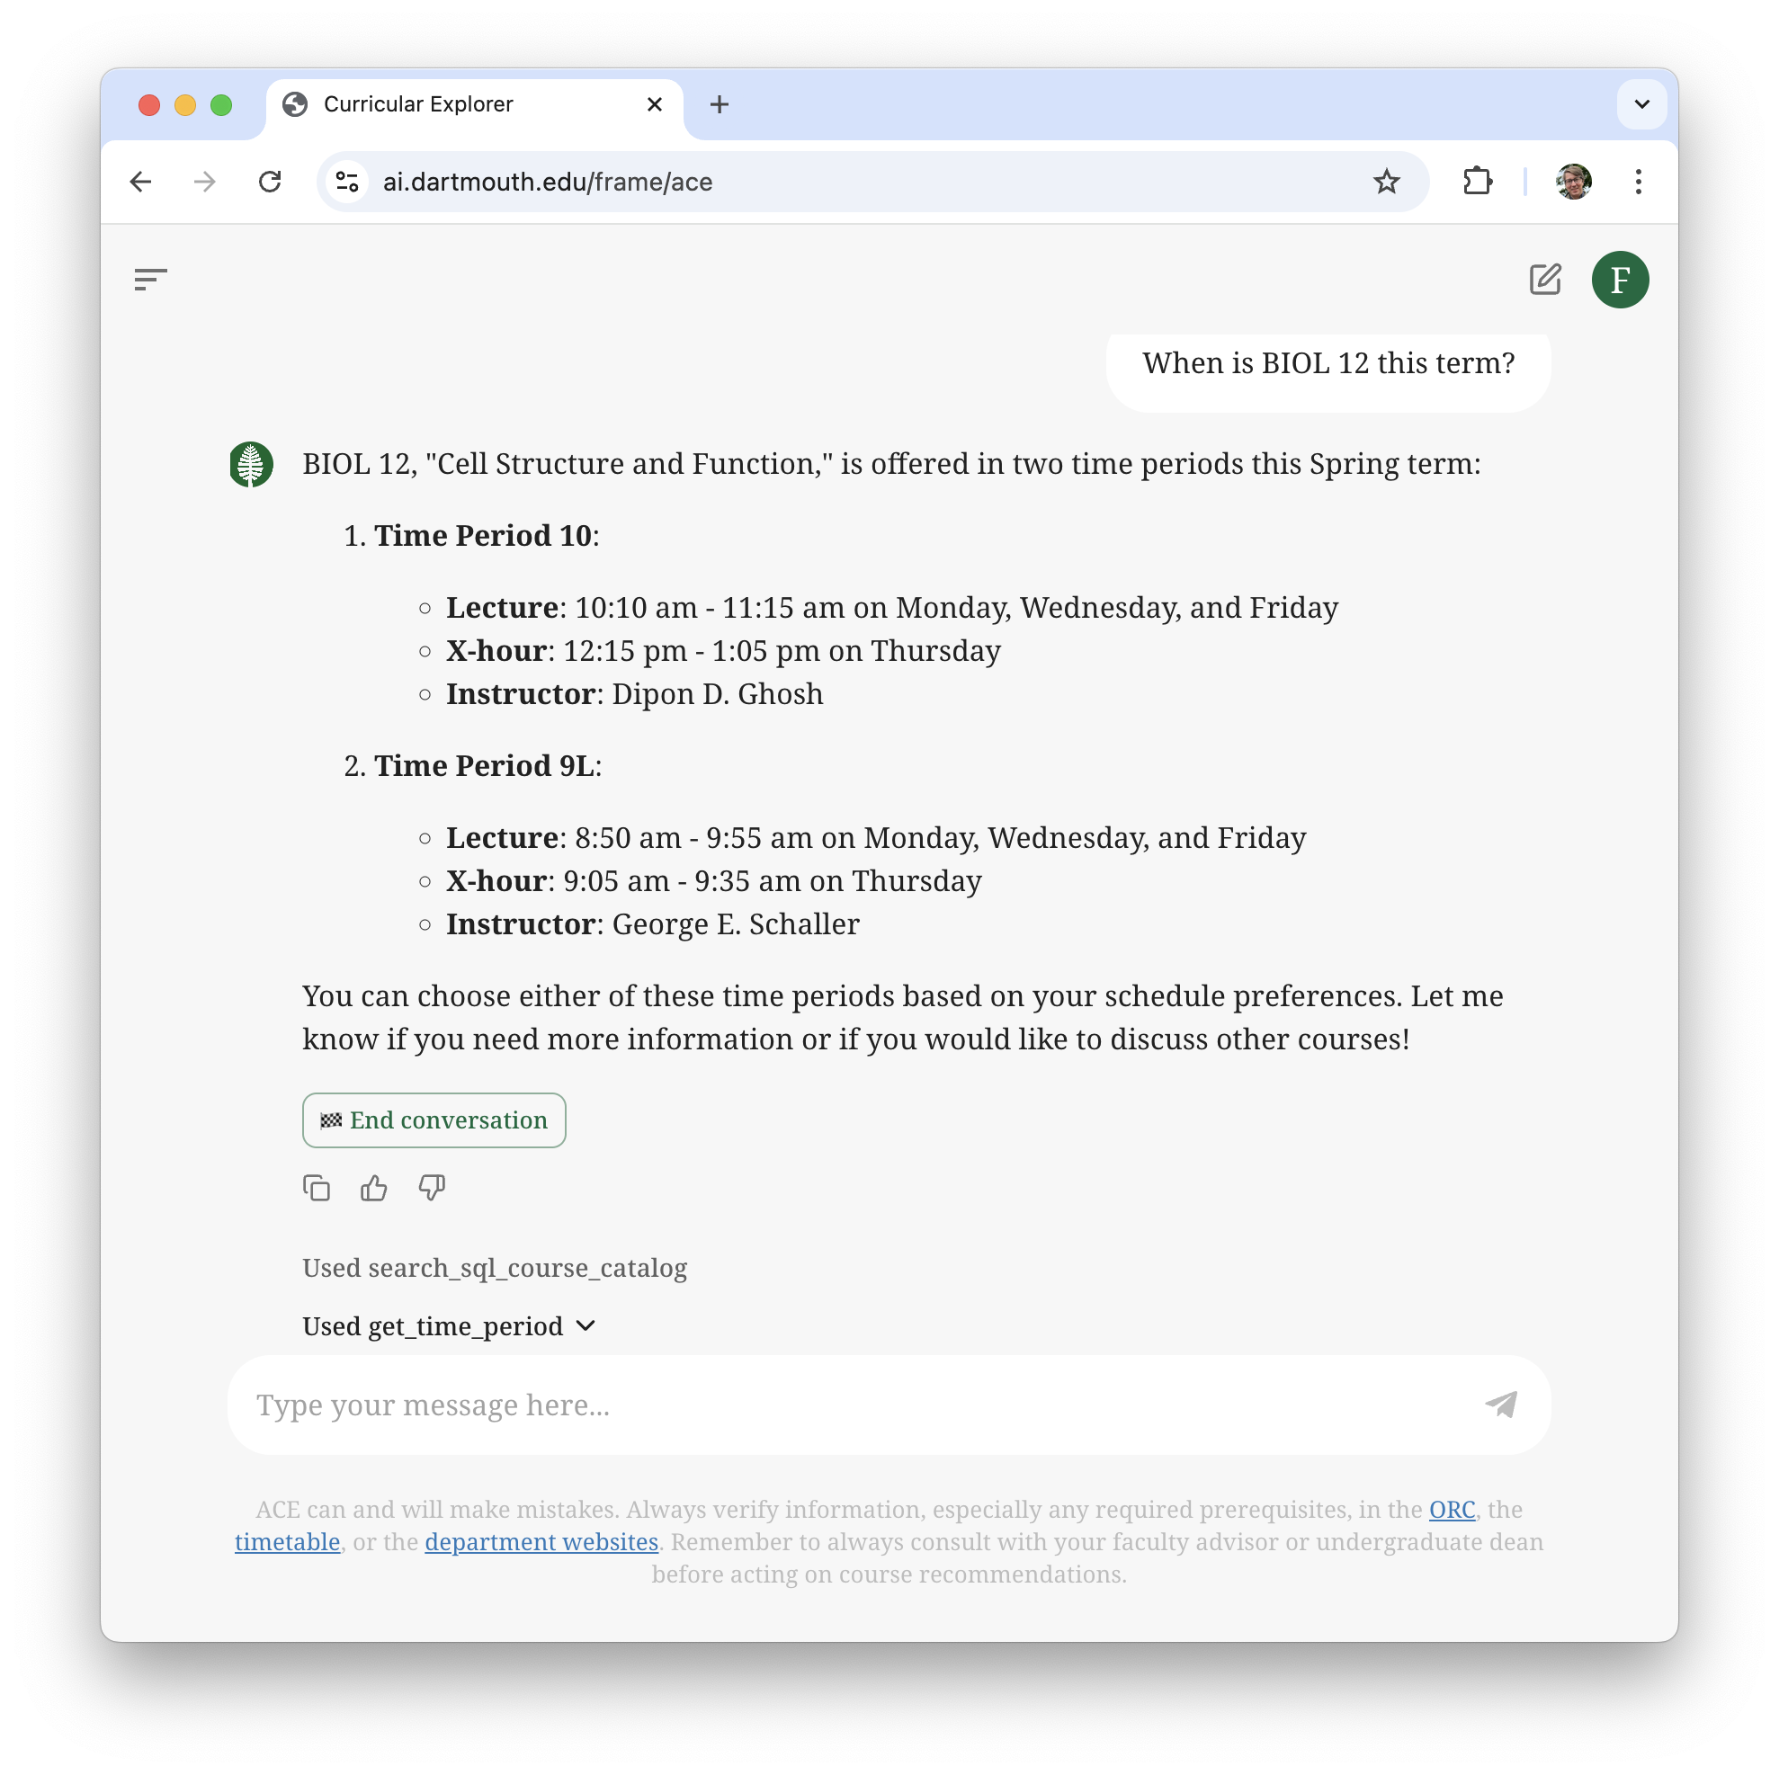
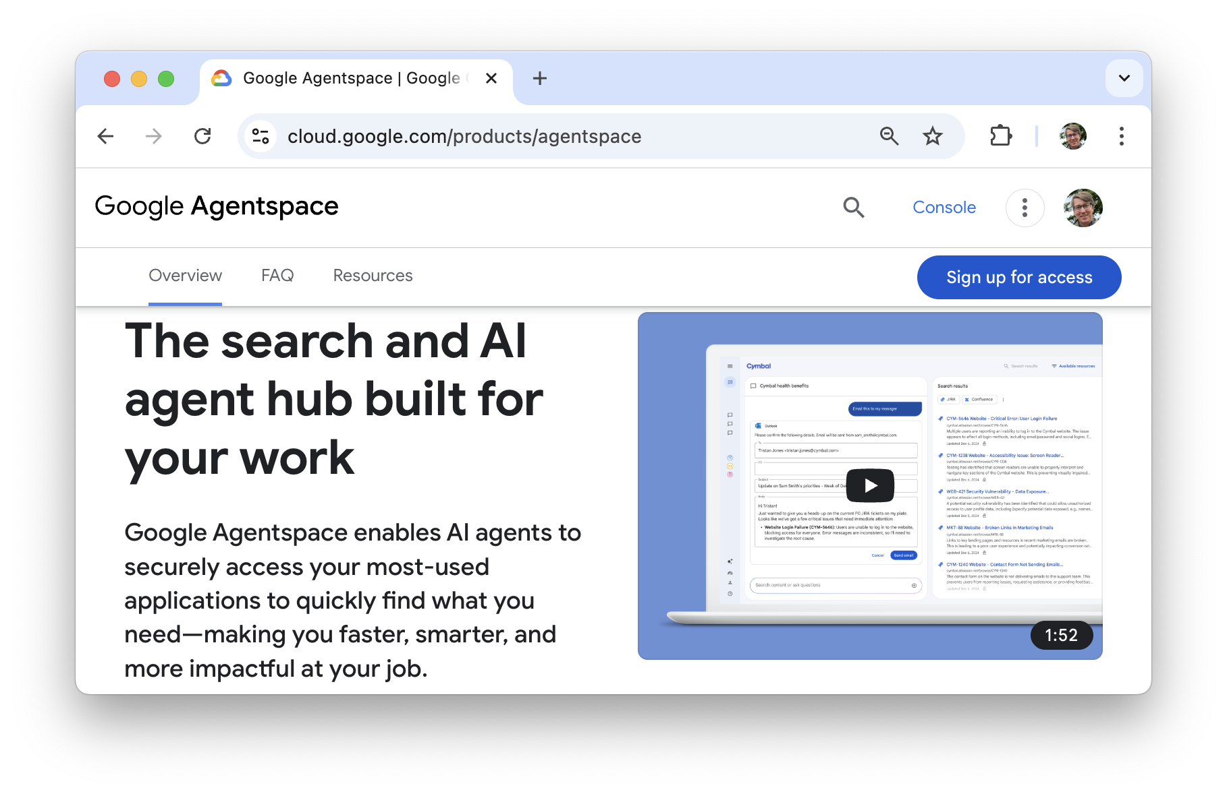
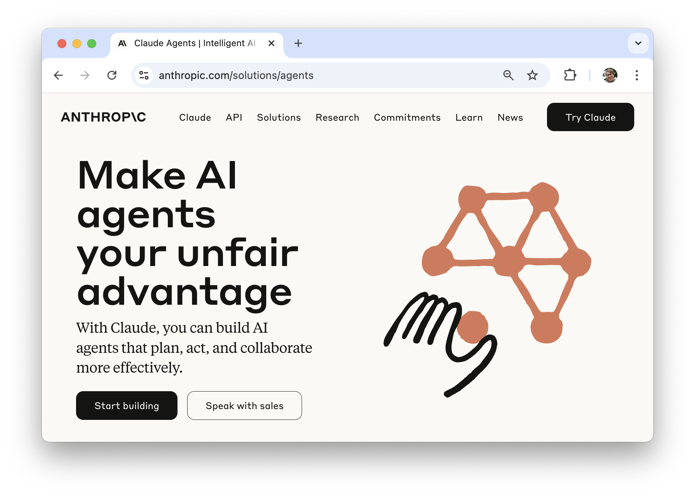

Slide 5
What we will cover in this session
What is Agentic AI?
How do AI Agents work?
What are their strengths and limitations?
How can I create my own agents?
What is next in Agentic AI?

Slide 6

Agentic Artificial Intelligence
Agentic Artificial Intelligence can act autonomously without human intervention
An AI Agent is a concept describing a system that can:
Decide on the next action(s) to take to achieve a stated goal
Execute those actions
Adapt to changes in its environment to continue until the goal is achieved
Large Language Models (LLMs) have huge potential for AI Agents

Slide 7

Agentic Artificial Intelligence
Beyond Chatbots: Intro to Agentic Applications
Agentic Artificial Intelligence can act autonomously without human intervention
An AI Agent is a concept describing a system that can:
Decide on the next action(s) to take to achieve a stated goal
Execute those actions
Adapt to changes in its environment continue until the goal is achieved
Large Language Models (LLMs) have huge potential for AI Agents
Lumos
set_light(on=True)

Slide 8
Large Language Models and AI Agents
LLM can talk itself through the decision-making process
Decide on the next action(s) to take to achieve a stated goal
Execute those actions
Adapt to changes in its environment to continue until the goal is achieved
LLM-generated code can be executed to perform actions
The result of the code can be described to the model as text (or image, if multimodal LLM)

Slide 9
Demo in Dartmouth Chat
Naïve approach: Let the model write all the code
Improved approach: Tell the model which functions it can call

Slide 10
The Agentic Loop
Plan
Execute
Reflect
Goal achieved
LLM
LLM or human
Code
“Human in the loop”

Slide 11
The Agentic Loop LangChain Examples
Manual function calling / tool use
Automated feedback loop

Slide 12
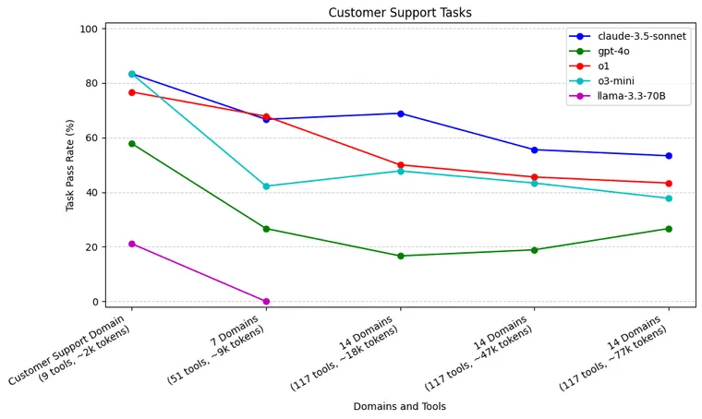
The Agentic Loop Limitations
Agents are best with a small number of tools
Complex tasks require multiple agents
Coordination between agents becomes a challenge
Source: https://blog.langchain.dev/react-agent-benchmarking/

Slide 13
The Agentic Loop
Plan
Execute
Reflect
Goal achieved
LLM
LLM or human
Code or other agent
Code
“Human in the loop”

Slide 14
Multi-Agent Application
Plan
Execute
Reflect
Plan
Execute
Reflect
🧰
🧰
Hand-off
Plan
Execute
Reflect
🧰
Agent 3
Agent 1
…
Hand-off
Agent 2

Slide 15
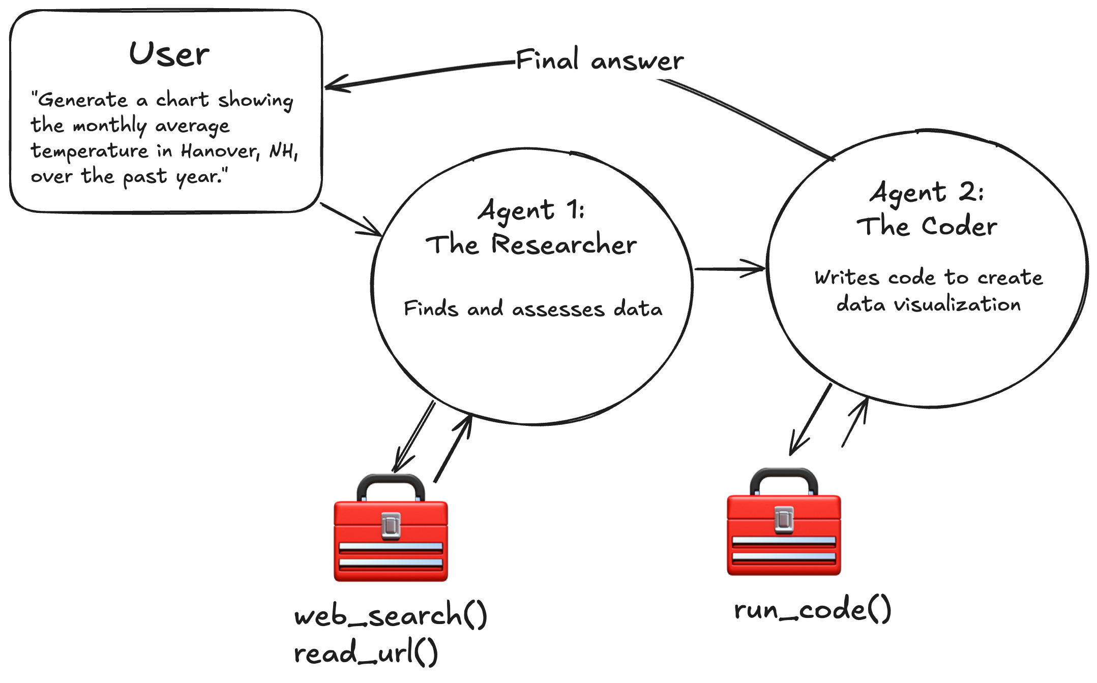
Multi-Agent Application Example Architectures: The Chain of Specialists

Slide 16
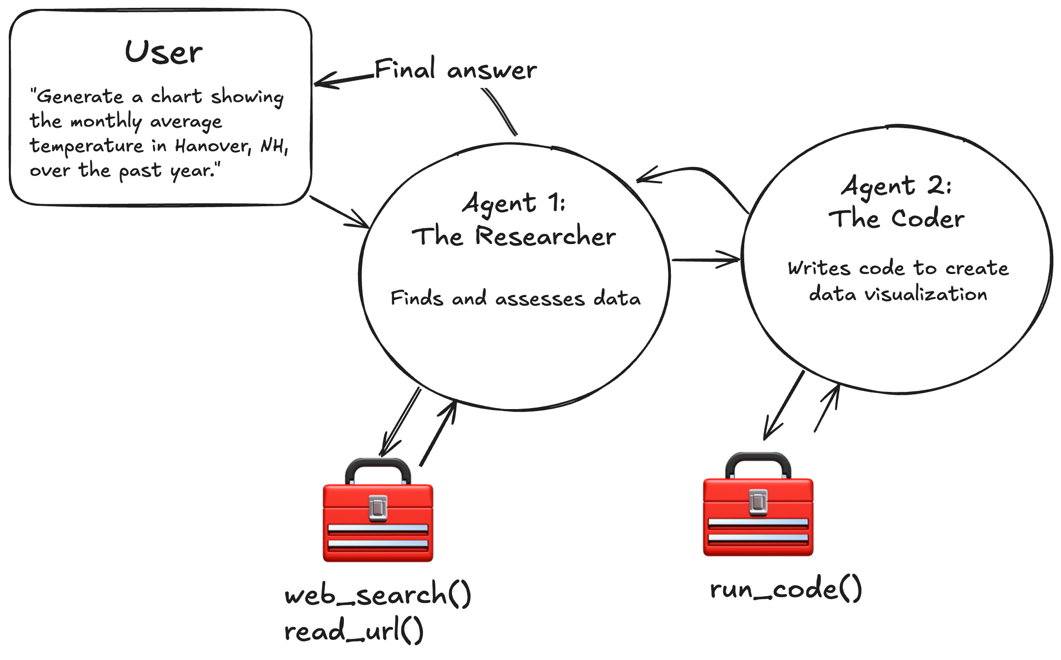
Multi-Agent Application Example Architectures: The Network of Specialists

Slide 17
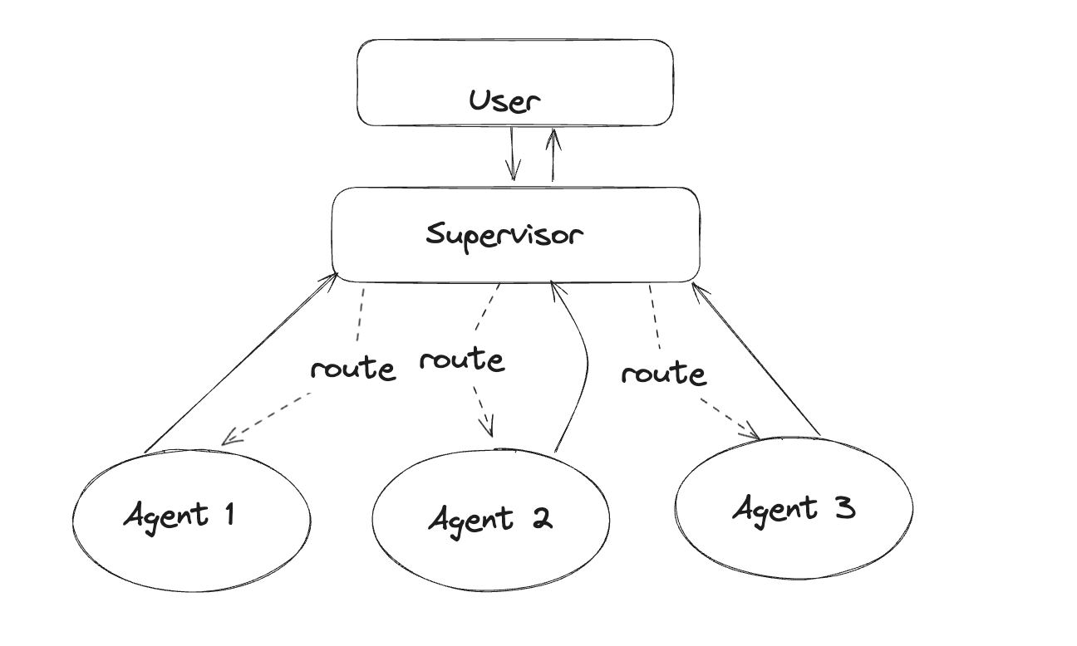
Multi-Agent Application Example Architectures: The Supervisor
Source: https://blog.langchain.dev/langgraph-multi-agent-workflows/

Slide 18
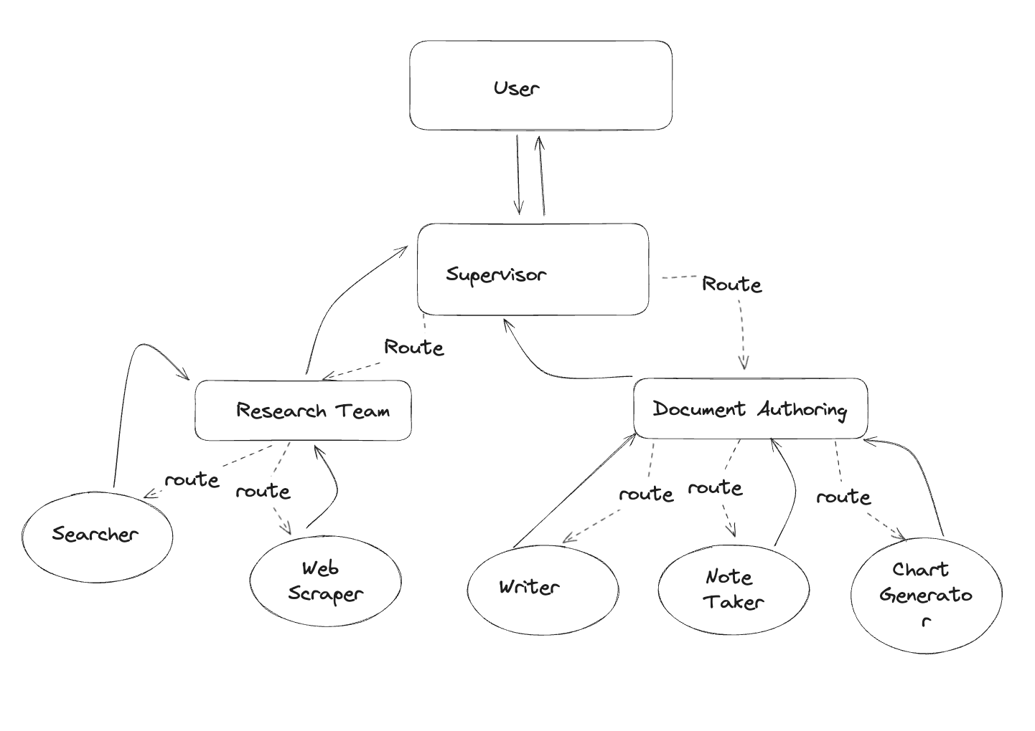
Multi-Agent Application Example Architectures: Hierarchical Teams
Source: https://blog.langchain.dev/langgraph-multi-agent-workflows/

Slide 19
Multi-Agent Application LangGraph Example

Slide 20




Highly scientific benchmark of current Agentic AI
Tool use sometimes suboptimal
Often still gets the job done
Better with a human-in-the-loop
Bumbling chaos agent
Ruthlessly effective

Slide 21
Current trends in Agentic AI
Model Context Protocol: Standardized way to make tools and resources available to LLMs
llms.txt: Standardized way to provide information about a website’s structure to an LLM agent
Agents on the Edge: Smaller LLMs with improved, on-device agentic capabilities

Slide 22
Summary
Agents are LLMs that can interact with the “real world”
Interactions are facilitated through functions (i.e., executable code)
Complex tasks require multiple agents
Finding the best architecture can be challenging (agent orchestration)
Agentic AI is still in its infancy, but steadily getting more capable

Slide 23
Next Steps
Try out some agentic applications and try to infer the underlying architecture
Explore LangChain, LangGraph, Pydantic AI, or other agentic frameworks
Create your own agentic app or reach out to research.computing@dartmouth.edu and we can help!

Slide 24
Thank you
dartgo.org/agentic-applications

